Slide 1
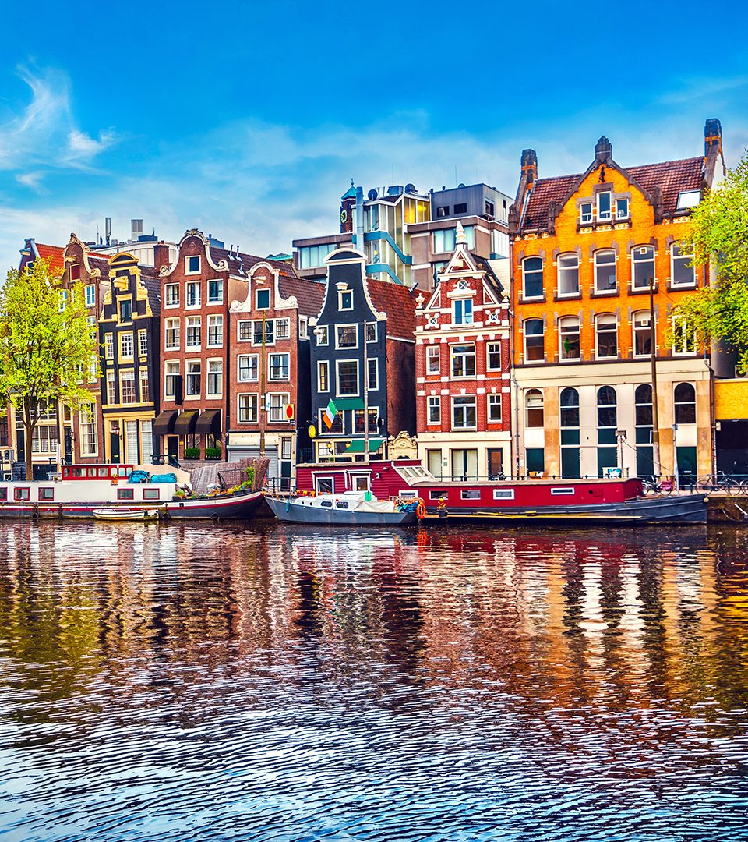

Slide 2
Investment Case: Quantifying Civil Society Contributions towards 90-90-90
Solange Baptiste
Executive Director
July 21, 2018
International Treatment Preparedness Coalition (ITPC)
Notes:
Looking at communities within civil society – ITPC best positioned to give insights about

Slide 3
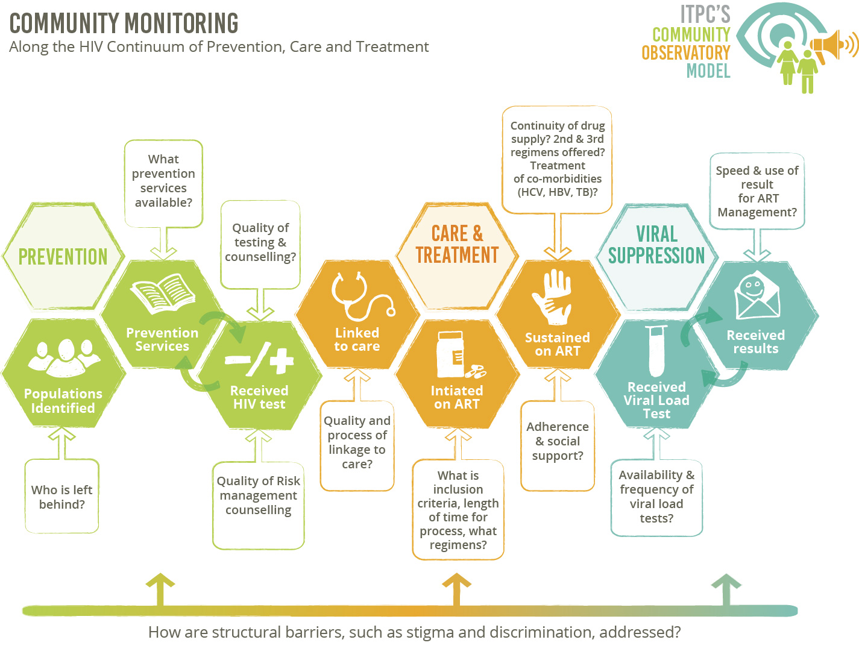
How do communities measure progress towards 90-90-90 targets?
90
90
90
Notes:
Just heard from WHO and MSF, but want to look at 90 90 90 from community perspective.

Slide 4
CONTINUNITY
QUALITY
Notes:
Key issues around quality and continuity – what do these metrics look like?

Slide 5
Is doing the best for most, doing enough?
Notes:
Notion in public health that we must do what is best for the good of most. But there is an inherent danger in doing that and in order to achieve 90 90 90 and to truly BEND the curve we must ask the question…

Slide 6
90
90
90
What does this picture look like by sub-population?
What does this picture look like by age disaggregation?
What does this picture look like by a rights-based focus / lens?
What does this picture look like by region or geographical location?
What does this picture look like by investment, policy, skill and interest?

Slide 7
What does 90-90-90 really mean?
10%
19%
27%
90%
Know status
81%
On ART
73%
VS
Notes:
90 90 90
90 81 73
10 19 27

Slide 8
Broad Agreement that More Robust Investments in Communities are needed to achieve Epidemic Control.
So, how do we bend the curve, achieve epidemic control, deal with this gap, what’s the critical investment?
INVEST IN COMPREHENSIVE COMMUNITY RESPONSES!
Notes:
Chorus of stakeholders – on one disagrees, yet few funders do this well.

Slide 9
Investments in Community Responses are Critical to Achieving 90-90-90
UNAIDS:
– …strong civil society engagement is critical for the implementation of its 2016-2021 strategy. The strategy recognizes civil society’s role in the AIDS response as a global public good, with mounting evidence of its positive impact, which requires legal and social space, as well as financial resources to ensure its effectiveness.
[UNAIDS (2016). On the Fast-Track to end AIDS – UNAIDS 2016–2021 Strategy. Page 49. Online at http://www.unaids.org/sites/default/files/media_asset/20151027_UNAIDS_ PCB37_15_18_EN_rev1.pdf]

Slide 10
Investments in Community Responses are Critical to Achieving 90-90-90
PEPFAR:
– …strengthen commitment to inclusiveness and building a stronger civil society by supporting and building the capacity of global and regional civil society networks.
– …implement civil society and human rights frameworks in all their priority countries.
[Birx, D. (2015). Building a Stronger Civil Society to Achieve an AIDS-Free Generation. Online at https://blogs.state.gov/stories/2015/09/29/building-stronger-civil-soci- ety-achieve-aids-free-generation; PEPFAR (2013). PEPFAR 3.0 – Controlling the Epidemic: Delivering on the Promise of an AIDS-free Generation. Page 27. Online at http://www.pepfar.gov/documents/organization/234744. pdf

Slide 11
Investments in Community Responses are Critical to Achieving 90-90-90
GLOBAL FUND:
The Global Fund’s investment case for the 2017-2019 replenishment, recognizes the importance of increasing funding for community responses. The Investment Case costing builds in assumptions of shifting more care from facility to community level.
The Global Fund’s new strategy for the period 2017-2022 also has a heavy focus on community systems and responses, as well as gender and human rights.
http://icaso.org/wp-content/uploads/2017/03/ICASO-Community-Report_Final-ZK-Feb-27.pdf

Slide 12
Investments in Community Responses are Critical to Achieving 90-90-90
GLOBAL FUND:
…maximize impact among key populations by focusing on data systems, strengthening community systems for increased advocacy, monitoring and service delivery capacity
… strategy has the building of resilient and sustainable systems for health as one of its four core objectives, with the aim to ensure well-functioning and responsive health and community systems.
UNAIDS-Lancet Commission:
Called on the global community to “invest in activism as a global public good.”
http://icaso.org/wp-content/uploads/2017/03/ICASO-Community-Report_Final-ZK-Feb-27.pdf

Slide 13
Increasingly channeling more money towards strengthening community delivery models is both more efficient, in that it is cost-saving, but also more effective, improving the uptake of services by bringing them closer to the people who need them.
[The Global Fund (2015). Investment Case for the Global Fund’s 2017-2019 Replenishment: The Right Side of the Tipping Point For AIDS, Tuberculosis and Malaria.
Presented on 17 December 2015 at the Global Fund’s Fifth Replenishment Preparatory Meeting in Tokyo, Japan.
Page 17. Online at http://www.theglobalfund.org/documents/publications/other/Publication_In- vestmentCase_Report_en/]
http://icaso.org/wp-content/uploads/2017/03/ICASO-Community-Report_Final-ZK-Feb-27.pdf

Slide 14
Compelling evidence that there are both allocative and technical efficiencies
to be realized by investing more money in strengthening community responses.
http://icaso.org/wp-content/uploads/2017/03/ICASO-Community-Report_Final-ZK-Feb-27.pdf

Slide 15
YET…

Slide 16
State of “Community Response” Funding
UNAIDS suggests that investments in community mobilization should increase threefold to 3%, and spending on social enablers should reach 8% of total expenditure by 2020.
40% of organizations tasked with implementing community activities reported a funding decrease since 2013. Two thirds expected flat or declining funding in the future. PEPFAR reduced its investments in community-based care, treatment and support by 12.6% from 2013 to 2014.
The Global Fund’s Technical Review Panel has expressed concern that the majority of concept notes are not including funding requests for the community systems strengthening module at all. An investment case for community responses is needed to motivate the necessary levels of funding.
http://icaso.org/wp-content/uploads/2017/03/ICASO-Community-Report_Final-ZK-Feb-27.pdf

Slide 17
Invest and You Shall Receive…
Communities:
Use funds for intended purpose and ultimately save lives
Know what’s best in their context, innovates and scales
Produce reliable, actionable data
Sustain work beyond the project as much as is possible
Demand what they need from their governments
Are a partner in the HIV response, not a victim
Notes:
If focus should include the Quality and Who is left behind, who is best to do that?

Slide 18
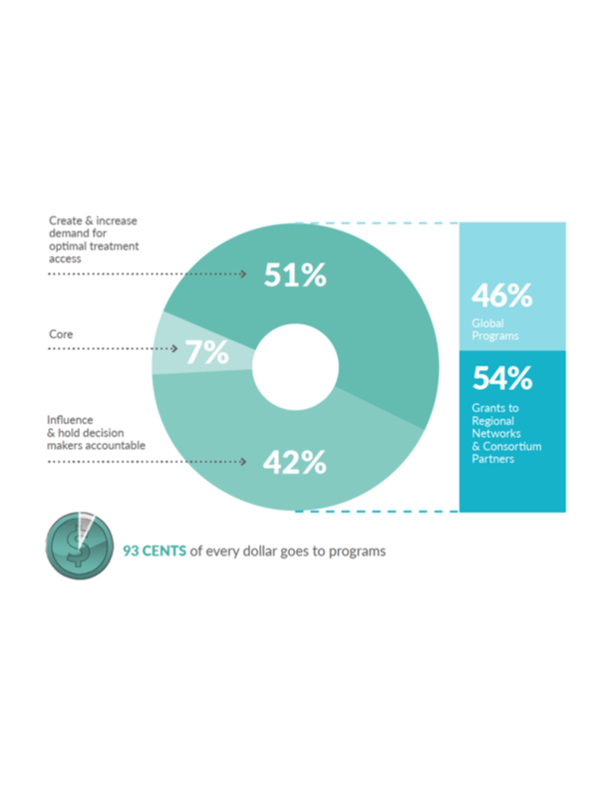
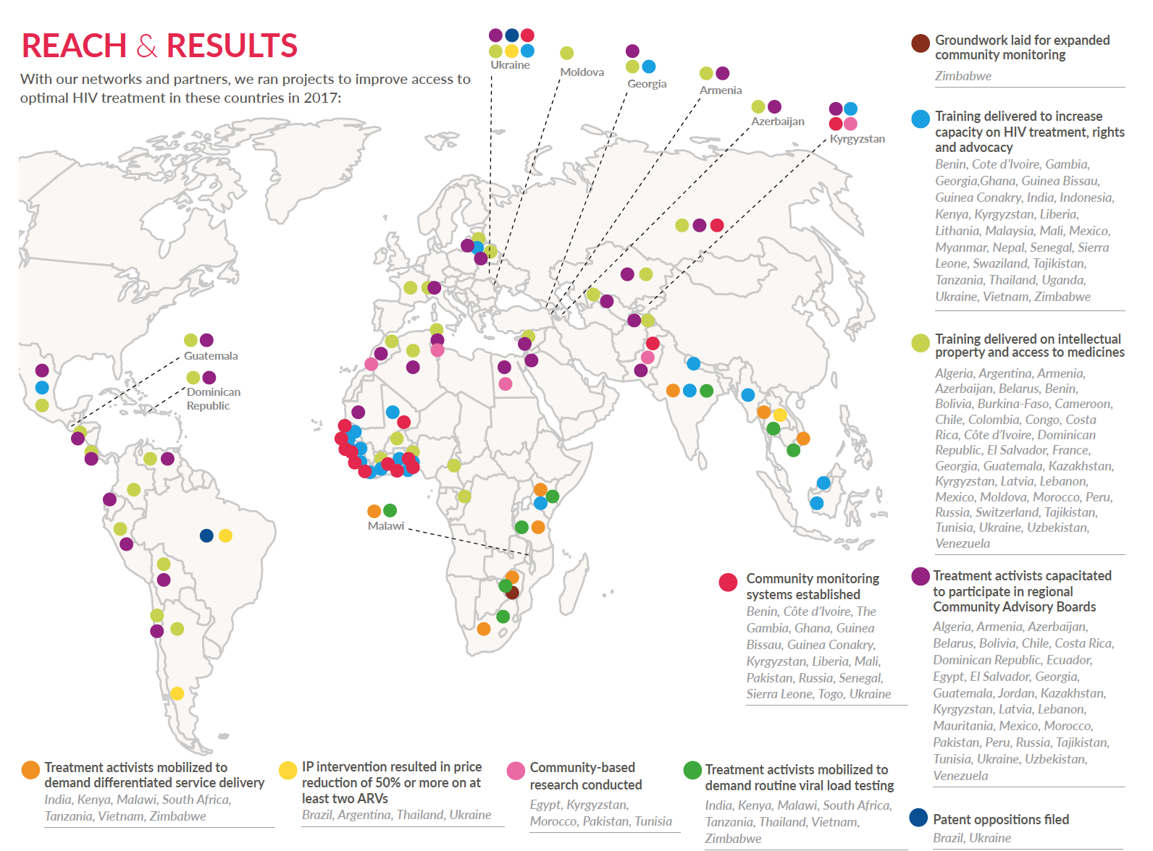
Value for Money

Slide 20
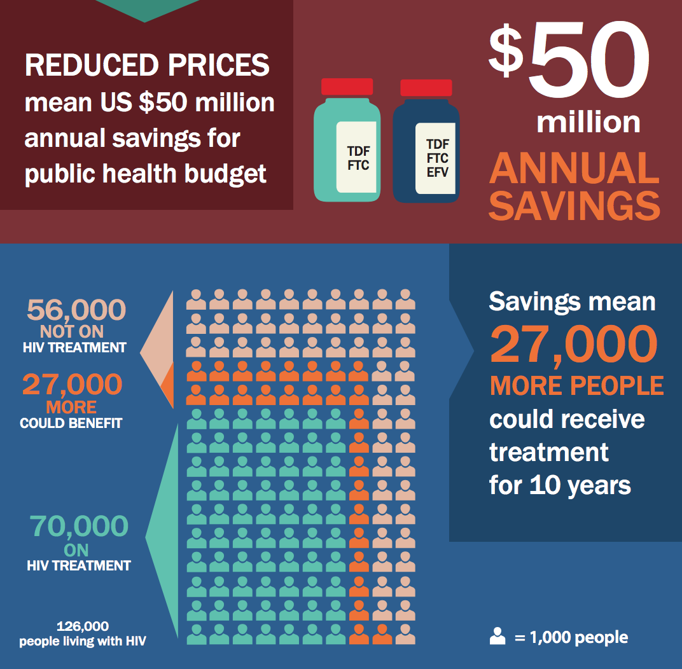

Slide 21
So, what now?
Fund community responses NOW, to secure the returns from 30+ years of investments already made and to save money in the future.
Have honest discussions about why donors are hesitant to invest in communities!!
Conduct better resource tracking of investments in community responses.
Conduct more frequent and more rigorous impact assessments for community responses.
Fund communities for: treatment education, monitoring, systems strengthening (organizations, financial, programmatic, governance) and advocacy!
Invest in communities as a global public good!!

